Slide 1
GNU flex & bison
01076262 Compiler Construction

Slide 2
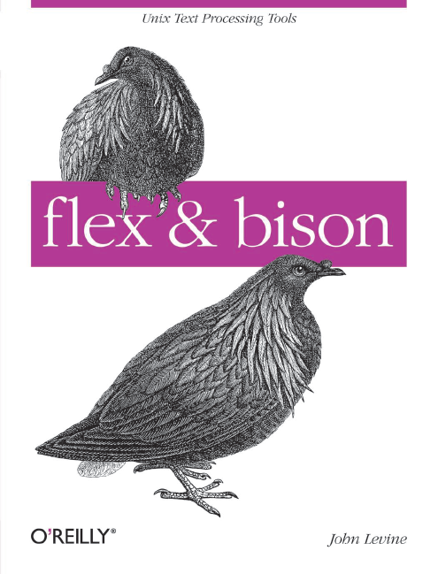
Reference
flex & bison
John Levine
O’Reilly
ISBN: 978-0-596-15597-1

Slide 3
History (1)
In 1975, Mike Lesk and summer intern Eric Schmidt wrote lex, a lexical analyzer generator, with most of the programming being done by Schmidt. They saw it both as a standalone tool and as a companion to Johnson’s yacc.
It also became quite popular, despite being relatively slow and buggy. (Schmidt nonetheless went on to have a fairly successful career in the computer industry where he is now the CEO of Google.)

Slide 4
History (2)
A parser generator written between 1975 and 1978 by Stephen C. Johnson at Bell Labs. As its name, short for “yet another compiler compiler”, suggests, many people were writing parser generators at the time.
Johnson’s tool combined a firm theoretical foundation from parsing work by D. E. Knuth, which made its parsers extremely reliable, and a convenient input syntax.

Slide 5
History (3)
In about 1985, Bob Corbett, a graduate student at the University of California, Berkeley, reimplemented yacc using somewhat improved internal algorithms, which evolved into Berkeley yacc.
Since his version was faster than Bell’s yacc and was distributed under the flexible Berkeley license, it quickly became the most popular version of yacc.

Slide 6
History (4)
Richard Stallman of the Free Software Foundation (FSF) adapted Corbett’s work for use in the GNU project, where it has grown to include a vast number of new features as it has evolved into the current version of bison. Bison is now maintained as a project of the FSF and is distributed under the GNU Public License.

Slide 7
History (5)
In about 1987, Vern Paxson of the Lawrence Berkeley Lab took a version of lex written in ratfor (an extended Fortran popular at the time) and translated it into C, calling it flex, for “Fast Lexical Analyzer Generator.”
Since it was faster and more reliable than AT&T lex and, like Berkeley yacc, available under the Berkeley license, it has completely supplanted the original lex. Flex is now a SourceForge project, still under the Berkeley license.

Slide 8
flex – Outline
$ flex foobar.flex
$ gcc lex.yy.c –lfl –o foobar.exe
Most flex programs now use %option noyywrap and provide their own main routine, so they don’t need the flex library.
$ foobar.exe < limbo.txt

Slide 9
flex – Example #1
/* just like Unix wc */
%{
int chars = 0;
int words = 0;
int lines = 0;
%}
%%
[a-zA-Z]+ { words++; chars += strlen(yytext); }
\n { chars++; lines++; }
. { chars++; }
%%
main(int argc, char **argv)
{
yylex();
printf("%8d%8d%8d\n", lines, words, chars);
}

Slide 10
flex – Example #1 Result
$ ./foobar.exe
The boy stood on the burning deck
shelling peanuts by the peck
^D
2 12 63
$

Slide 11
flex – Example #2
/* recognize tokens for the calculator and print them out */
%%
"+" { printf("PLUS\n"); }
"-" { printf("MINUS\n"); }
"*" { printf("TIMES\n"); }
"/" { printf("DIVIDE\n"); }
"|" { printf("ABS\n"); }
[0-9]+ { printf("NUMBER %s\n", yytext); }
\n { printf("NEWLINE\n"); }
[ \t] { }
. { printf("Mystery character %s\n", yytext); }
%%

Slide 12
flex – Example #2 Result
$ ./foobar.exe
12+34
NUMBER 12
PLUS
NUMBER 34
NEWLINE
5 6 / 7q
NUMBER 5
NUMBER 6
DIVIDE
NUMBER 7
Mystery character q
NEWLINE
^D
$

Slide 13
flex – Example #3 (1)
/* recognize tokens for the calculator and print them out */
%{
enum yytokentype { NUM=258, ADD, SUB, MUL, DIV, ABS, EOL };
int yylval;
%}
%%
"+" { return ADD; }
"-" { return SUB; }
"*" { return MUL; }
"/" { return DIV; }
"|" { return ABS; }
[0-9]+ { yylval = atoi(yytext); return NUM; }
\n { return EOL; }
[ \t] { /* ignore whitespace */ }
. { printf("Mystery character %c\n", *yytext); }
%%

Slide 14
flex – Example #3 (2)
main(int argc, char **argv)
{
int tok;
while(tok = yylex()) {
printf("%d", tok);
if (tok == NUM)
printf(" = %d\n", yylval);
else
printf("\n");
}
}

Slide 15
flex – Example #3 Result
$ ./foobar.exe
a / 34 + |45
Mystery character a
262
258 = 34
259
263
258 = 45
264
^D
$

